Slide 1
Creating a Script to Gather Data and Create a Report
Notes:
[Mandatory Slide] This would be the introduction slide of the topic that you are covering in this subsection.
When this slide plays, you could talk about the main aim that we’d be covering in this video.

Slide 2
In this Video, we are going to take a look at…
Inserting the help section

Slide 3
In this Video, we are going to take a look at…
Inserting the help section
Naming the script

Slide 4
In this Video, we are going to take a look at…
Inserting the help section
Naming the script
Laying out the command section

Slide 5
In this Video, we are going to take a look at…
Inserting the help section
Naming the script
Laying out the command section
Using 3rd party tools for scripting

Slide 6
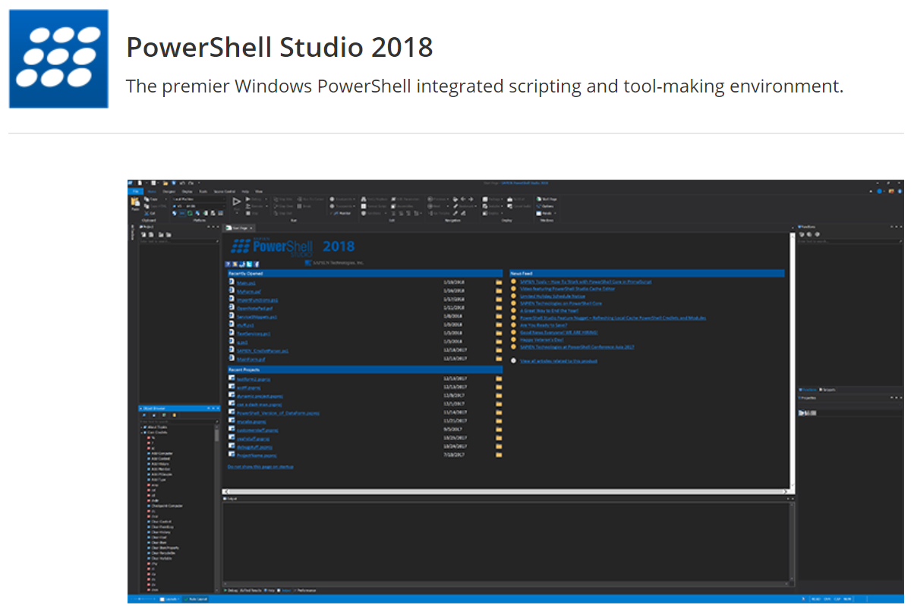

Slide 7

Dr. Tobias Weltner

Slide 8
Generate a Script to Set Up a New User
Next Video
Notes:
[Mandatory Slide] This would be the slide of the next video that you will be covering.
When this slide plays, you could talk about the main aim that we’d be covering in the next video.

